Slide 1

Web Page Archiving and Content Analysis 1.0
Team Members: Juan Alvarado, Mark Fajet Product Owner: Mark Finlayson
Instructor: Masoud Sadjadi School of Computing and Information Sciences Florida International University
Final Presentation
Spring 2018
Notes:
7 seconds.( I will select 2 best slides (i will give them extra points and students will present for CIS committee)
Greet your audience, thank them for attending your presentation, introduce yourself, introduce your project, introduce your team members, and quickly indicate what each of you did in a high-level manner, and put more emphasis on your part/contribution.

Slide 2
Project definition
Notes:
10 seconds.
Introduce the problem that the whole project (in all versions) tackles with GIF or screenshot.

Slide 3
Project definition
Screenshots or GIF pictures of the new version
Notes:
20 seconds.
Introduce the problem that the your project (in new version) tackles with GIF or screenshot.

Slide 4
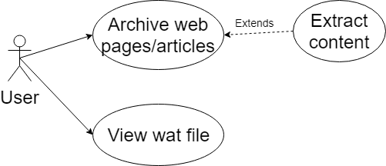
Requirements: Use Cases
Notes:
5 seconds
Show the Use Case Diagram for the whole project. Highlight your use cases.

Slide 5
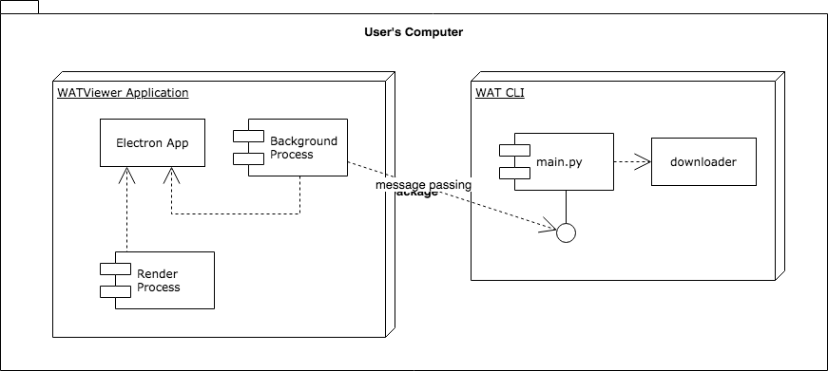
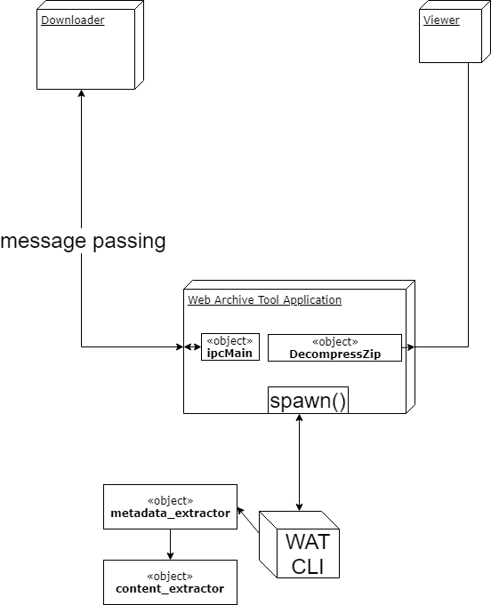
System Design: Architecture
Notes:
20 seconds
System design: Highlight the parts that you contributed to them.
1. System decomposition; identify the architecture patterns used
2. System deployment – h/w and s/w requirements

Slide 6
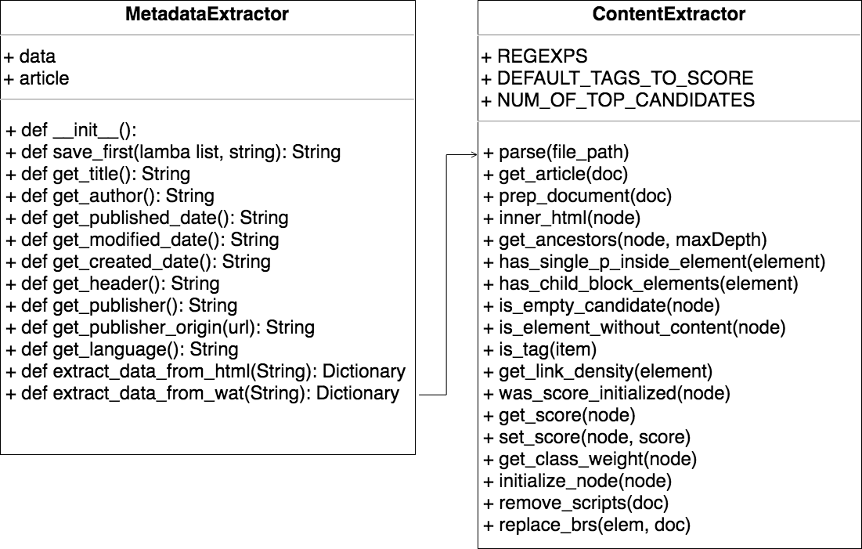
Minimal Class Diagram
Notes:
10 seconds.Minimal class diagram. Highlight the classes that you created/modified
Identify the design patterns used (one or more slides).

Slide 7
User Stories
Complete text extraction implementation
Extract data from metadata
Reduce archive download time
WAT file restructuring
Watviewer application
Notes:
5 seconds.
List the user stories that you worked on them.(put in order of importance). Stay focused on the parts that you have been working.

Slide 8
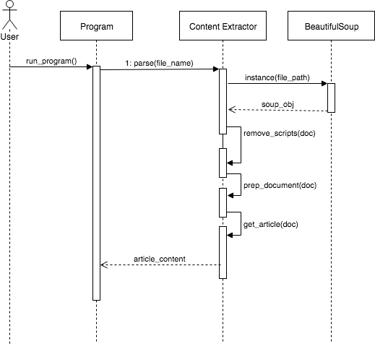
Complete text extraction implementation
Extract content of an page given html content
Abstracted as a module
Extraction done using page element scoring algorithm
Notes:
60 seconds
The tile of user story
The most important user story you worked on it. You have to describe this one very well and be proud of that.
Please present and show the complexity of your work, code, algorithms, and technical challenges and technologies you have used. (you could use screenshot if you want. Visual presentations are better than text presentation)
Go into the details of the most important/significant tasks using bullet lists or visual graphs or state chart diagram
Sequence Diagram for this user story is mandatory (in another separate page if required)
Demo using screenshots or GIF (in another separate page if required)

Slide 9
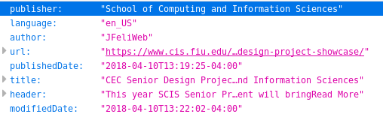
Extract data from metadata
Beautiful soup for navigating the DOM
lists of anonymous lambda functions to delay execution until necessary
Notes:
20 seconds
The tile of user story
Please present and show the complexity of your work, code, algorithms, and technical challenges and technologies you have used. (you could use screenshot if you want. Visual presentations are better than text presentation) - Go into the details of the most important/significant tasks using bullet lists or visual graphs or state chart diagram - Demo using screenshots or GIF (in another separate page if required)
Sequence Diagram for this user story is optional

Slide 10
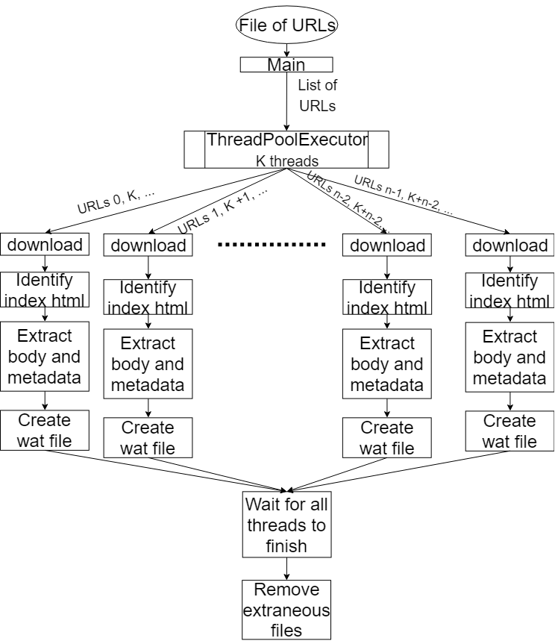
Reduce archive download time
Downloads split onto threads using ThreadPoolExecutor
Thread safe file operations and zipping
Thread pool allows number of threads to be specified and tasks split up
Notes:
20 seconds
The tile of user story
Please present and show the complexity of your work, code, algorithms, and technical challenges and technologies you have used. (you could use screenshot if you want. Visual presentations are better than text presentation) - Go into the details of the most important/significant tasks using bullet lists or visual graphs or state chart diagram - Demo using screenshots or GIF (in another separate page if required)
Sequence Diagram for this user story is optional

Slide 11
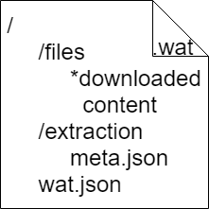
WAT file restructuring
All web page files, including multimedia encapsulated in a single, compressed file
Self-contained meta information describing contents of wat file
All extracted information saved for easy programmatic access
Easily extendable to include future work such as translations
Notes:
20 seconds
The tile of user story
Please present and show the complexity of your work, code, algorithms, and technical challenges and technologies you have used. (you could use screenshot if you want. Visual presentations are better than text presentation) - Go into the details of the most important/significant tasks using bullet lists or visual graphs or state chart diagram - Demo using screenshots or GIF (in another separate page if required)
Sequence Diagram for this user story is optional

Slide 12
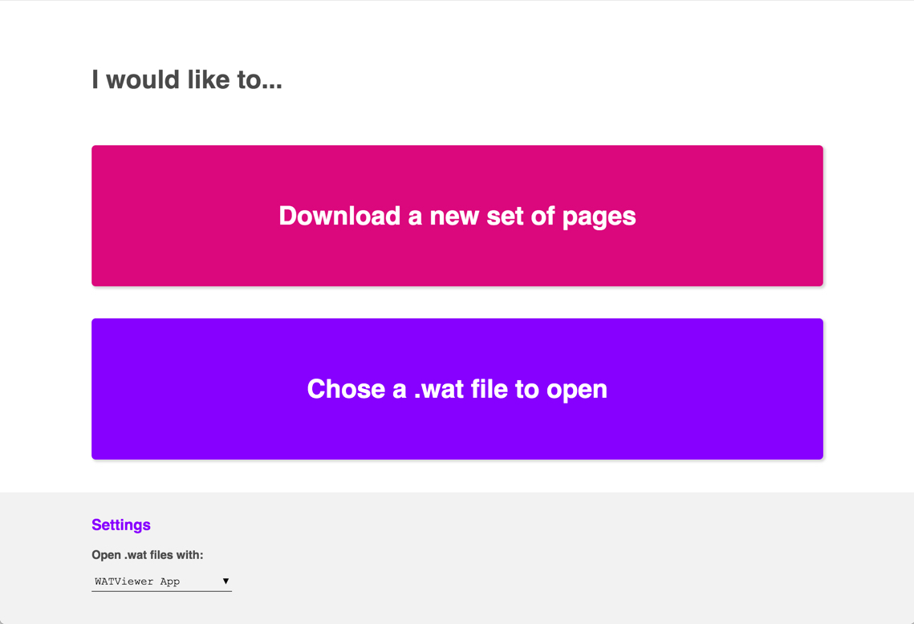

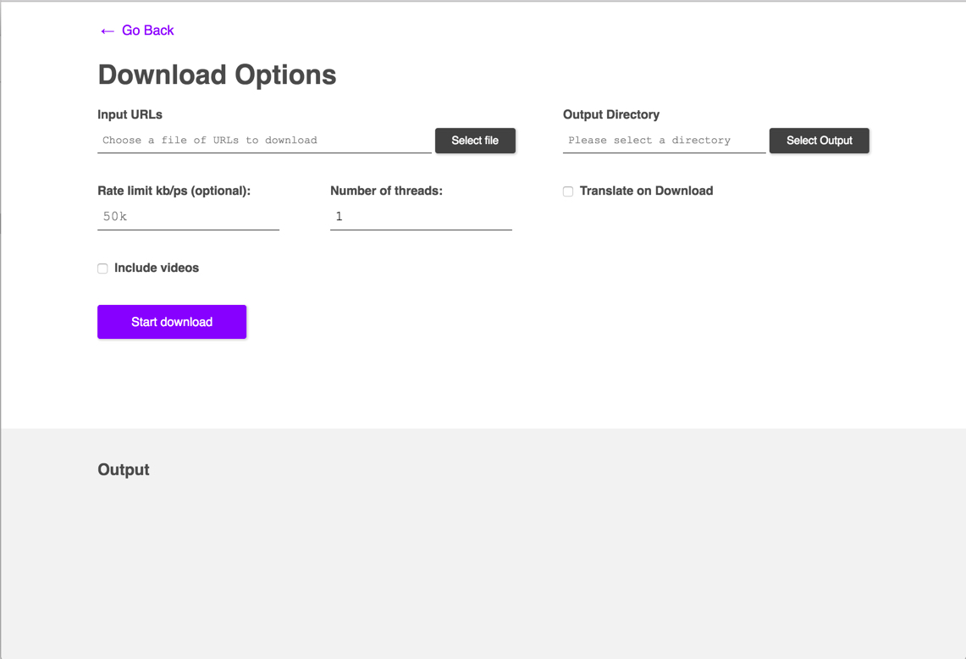
Watviewer application
Notes:
20 seconds
The tile of user story
Please present and show the complexity of your work, code, algorithms, and technical challenges and technologies you have used. (you could use screenshot if you want. Visual presentations are better than text presentation) - Go into the details of the most important/significant tasks using bullet lists or visual graphs or state chart diagram - Demo using screenshots or GIF (in another separate page if required)
Sequence Diagram for this user story is optional

Slide 13
Test Suites and Test Cases
Sunny day
Test case ID: 13
Description/Summary of Test: Download list of web pages
Pre-condition: valid txt file containing URLs separated by new line
Expected Results: Download finished with code 0
Actual Result: Download finished with code 0
Status (Fail/Pass): Pass
Notes:
10 seconds
A description of verification process and Test Suites and Test Cases for one of the use cases.
1 One sunny day and one rainy day for the implemented use cases (one or more slides).
2 Automated test scripts for the implemented use cases (if any) (one or more slides).

Slide 14
Test Suites and Test Cases
Rainy day
Test case ID: 14
Description/Summary of Test: Download invalid list of web pages
Pre-condition: invalid txt file not containing URLs separated by new line
Expected Results: Download finished with non-zero exit code
Actual Result: Download finished with non-zero exit code
Status (Fail/Pass): Pass
Notes:
10 seconds
A description of verification process and Test Suites and Test Cases for one of the use cases.
1 One sunny day and one rainy day for the implemented use cases (one or more slides).
2 Automated test scripts for the implemented use cases (if any) (one or more slides).

Slide 15




Summary
Summary
Juan Alvarado: jalva327@fiu.edu
Mark Fajet: mfaje002@fiu.edu
Questions?
Thank You!
Notes:
10 seconds
Summarize your contribution, mention your effort for Scrum, Mingle, Github, Google Drive Documentation and minutes
Include your contact information
Ask if anyone has any questions for you.
Thank your audience

